Slide 1
Supporting the Development and Learning of Modern Languages students abroad via the ePortfolio
Franck Michel
LLAS Language Futures Conference
Edinburgh 2012

Slide 2
What is an ePortfolio?
“An ePortfolio is the product, created by the learner, a collection of digital artefacts articulating experiences, achievements and learning. Behind any product, or presentation, lie rich and complex processes of planning, synthesising, sharing, discussing, reflecting, giving, receiving and responding to feedback. These processes – referred to here as ‘ePortfolio-based learning’ – are the focus of increasing attention, since the process of learning can be as important as the end product.” (JISC, 2008)

Slide 3
Background Context
e-Learning at university
Reshaping the ‘learning landscape’
Effective teaching/learning
Supporting personal development
Reflective practice
Diverse range of examples
The e-Portfolio
Newcastle University, School of Medical Sciences Education Development
Notes:
‘Learning landscape’ includes the physical architecture, the formal and informal relationships, the processes of teaching, learning and assessment, the deployment of technology and the other factors that combine to shape the nature of the student experience in higher education (Bell et al, 2009).
Diverse range of examples including Alverno College, US; University of Otago, New Zealand; University of Melbourne, Australia and as well as professional organisations such as the Chartered Society of Physiotherapists in the UK.

Slide 4
Embedding e-Portfolios in student learning: Newcastle University
2011/12 | 2012/13 | 2013/14
Student evaluation Consultations with staff Jan 2012: enhanced e-Portfolio live Semester 2 2011/12 pilots of e-Portfolio use | Students will have access to an e-Portfolio to support personal reflection and development of employability skills | Students will have the opportunity to use their e-Portfolio in meetings with their Personal Tutor to support the student in achieving personal, academic and professional goals
Source: Adapted from presentation given by Professor Barry Hirst, Dean of Postgraduate Studies (Medical Sciences), Newcastle University.

Slide 5
The Year Abroad ePortfolio (YAeP)
The Year Abroad – Key feature of a MFL degree
8 volunteers – Third Year students of German, French and Spanish
ePortfolio used regularly by participants to:
record daily-life experiences and challenges
define/review personal (learning) objectives
reflect on their development (personal, academic, professional) and skills
offer and receive feedback to/from peers
ePortfolio used as a Personal Tutoring tool
pastoral support (blog comments)
academic support (learning advice / review of objectives)

Slide 6
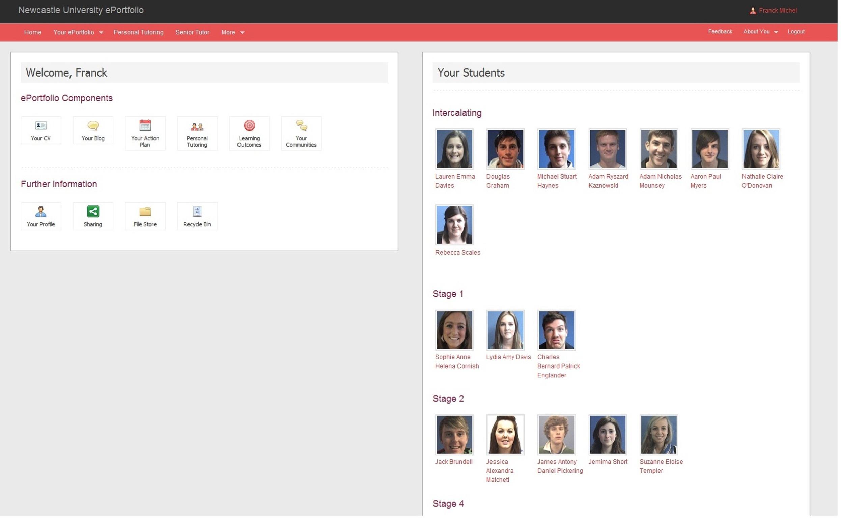
Notes:
Using my postgraduate e-portfolio as an example:
The e-portfolio is an e-learning too that can help us to reach educational aims and objectives, to manage learning and to engage students in appropriate learning activities as well as the potential for student assessment and access to student learning off campus.
It can help to motivate students, to provide instruments of feedback, to enable discussion on student performance and to cross reference a number of aspects of student work.
to follow her learning progress throughout her years of study. It helps the student process the feedback they receive from their faculty, external assessors and peers.
It also enables students to look for patterns in their academic work so that they can take more control of their own development and become an autonomous learner.
View it anytime, anywhere they have access to the internet
Store multimedia – text, audio and video files
Means to record placements, voluntary/paid work and achievements
CV

Slide 7
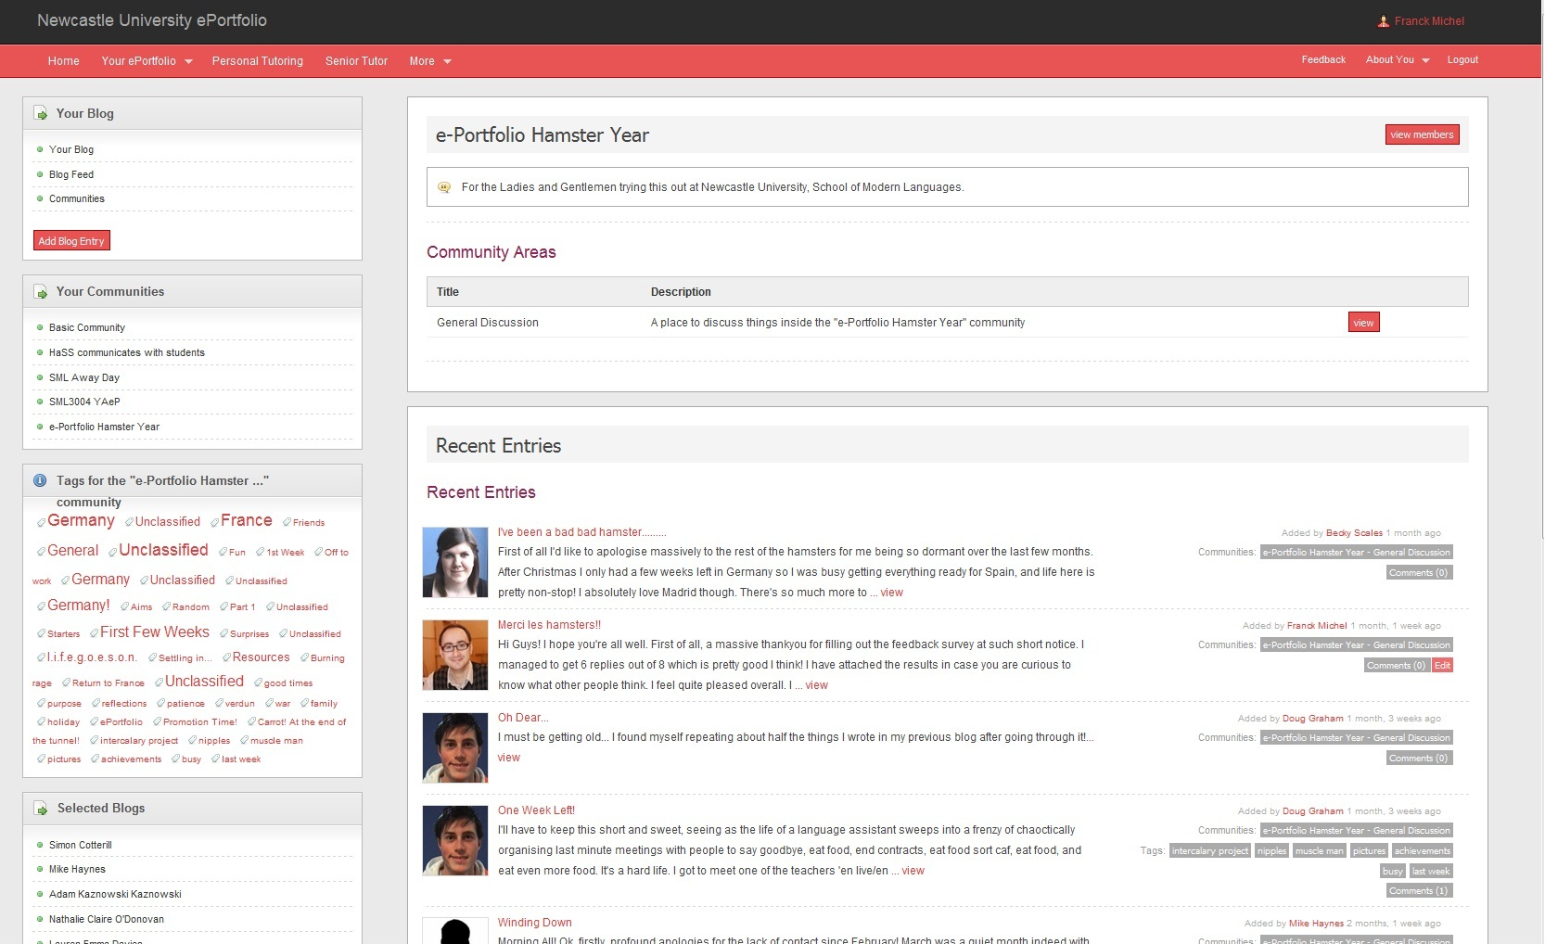

Slide 8
Success indicators
Academic community set up by students: the e-Portfolio Hamster Year
Number of entries/comments recorded after 8 months:
95 student blog entries (average = 12 per participant)
129 comments overall (approx. 71 student comments)
Evidence of “serious” personal reflection
Evidence of genuine and spontaneous support/interaction between participants
Evidence of a “virtuous circle” between reflection, interaction and development

Slide 9
Evidence of personal reflection (M.’s blog)
“[The] main thing that was annoying me was the shock of going from Berlin […] to a teeny tiny town in very rural France. I never thought I'd get culture shock because I always imagined it'd be between home and wherever I went, but this snuck up on me! […]
Second thing was a blow to my confidence in terms of language development. At the beginning I COULD NOT get out of thinking-in-German mode and it was annoying me because I wanted to get into thinking-in-French mode ASAP to make the most of my time here.
On reflection I was panicking and after having calmed myself, I am now able to think in French (enough so that I'm happy with it anyway) without forcing it upon myself.
I also made a pact with myself that I'm going to teach myself French in my spare time because the level of interaction I have with people in the school and indeed, outside of it isn't enough to meet my high expectations.”

Slide 10
Evidence of personal reflection (M.’s blog)
“So, to that end I'm making a grammar sheet that makes grammar as easy to understand as possible and once that's done, I will make some grammar exercises to get it really cemented in my head. What's more, I also plan to get an audio and written diary going, so I can practice both my speaking and written language quite regularly. […]
I'm also making more of an effort to find people to speak with in the town. So I'm speaking to Max more often (he's also giving me a TV so I'll be able to watch TV without having to worry about stupid French school network problems, which at the moment don't allow me to watch TF1).
This afternoon, I'm going to go say bonjour to the Handball club and see what's occurin' there and whether I can get involved fairly often.
Failing that (or indeed, in addition to) I'm going to call the fencing and archery clubs and ask similar things. I think that will be enough to get my performance up to my high expectations of myself!!”

Slide 11
Evidence of reflection/support/interaction
Extract from D.’s blog:
“[…] I was on a downer after reading about how well A.'s doing in Lyon, and thinking, man I don't do that much. But how am I always busy?! Then I realised, just over 3 years ago I knew almost no French, so when we stop comparing ourselves to other people and look at our own progress, we can perhaps feel a bit more proud.”
A.’s comment:
“Next thing, I feel really bad that my blog in any way made you feel bad. That upsets me a lot. Without singing your praises too much, I think everyone knows that how far you personally have come in French is incredible and shows amazing dedication and language acquisition skills. More to the point, yes I'm having a great time - I won't deny that - but I'm jealous of things that you're doing, especially your personal experience of teaching because some of the lectures here, quite frankly, are worse than awful.”

Slide 12
Evidence of reflection/support/interaction
M.’s comment to D.’s post and A.’s comment:
“[…] But mainly, I have to say the past 5 minutes reading your post, D., and your reply, A., have been MORE than enlightening. I'm glad that I'm not the only one who's doubted my ability at some stage. […]
So yeah, D., I can sympathise with you on this one because, in all honesty, I've felt like my French is nowhere up to scratch since I started Uni. I went from being the best in class to mediocre at the best of times and it's a shock to the system. But the only thing to have changed was the canvas against which I was (and still am) set (Uni opposed to 6th form). I've still improved, more so than I ever have at anything (save for German), it's just that there are others who have been better since the beginning and who always will be better.”

Slide 13
Student views on the YAeP
67% felt it had been beneficial or very beneficial to their personal development
‘It gave me the freedom to reflect on my development, in my own way that was helpful to me’
‘It was a great way to see how I had progressed and whether I had kept to my targets or not’
‘Thought it was helpful, but it isn't something that I would continue to use if I didn't have to do it’
‘It is good for setting targets and hence tracking progress’

Slide 14
83% felt the ePortfolio had been beneficial or very beneficial as a feedback tool
‘This is probably the best bit of the ePortfolio - getting support and ideas from other students, and knowing that you're all "in the same boat" and going through similar experiences. Everybody has something to bring and encourage others with.’
‘It was good to be able to give feedback to others, and also nice to receive comments from my peers as that made me feel that what I wrote was actually being read.’

Slide 16
Embedding e-Portfolios in student learning: Challenges for ‘learners’
stimulating student engagement by promoting a sense of “ownership” among users
offering PDP & Reflective Practice training/guidance to help users achieve ‘deeper’ level of reflective learning
developing curriculum embedding
encouraging learners to share and incorporate feedback into their learning
emphasizing long-term benefits over short-term rewards

Slide 17
Embedding e-Portfolios in student learning: Challenges for ‘teachers’
Overcoming resistance to change
Developing an understanding of learner-centred pedagogies
Acknowledging that the e-Portfolio is not a ‘one size fits all’
Developing confidence in the use of technologies
Large-scale development planning
Coping with existing pressures

Slide 18
References
Bell, L., Stevenson, H., and Neary, M., (2009) The Future of Higher Education: Policy, Pedagogy and the Student Experience. London and New York : Continuum.
Biggs, J., (2003) Teaching for Quality Learning at University (2nd Edition). London: Open University Press.
Brockbank, A., and McGill, I., (2007) Facilitating Reflective Learning in Higher Education (2nd Edition). London: Open University Press.
Cotterill, S., Lowing, K., Cain., Lofthouse, R., Mackay, C., McShane, J., Stancliffe, D., and Wright, D., (2010) Blogs and e-Portfolios: Can they support reflection, evidencing and dialogue in teacher training? Journal of Learning Development in Higher Education. Special Edition: Researching PDP Practice, November 2010.
Cotterill, S., Horner, P., Teasdale, D., Ellis, J., Thomason, J.M., Vernazza, C., Bradley, P.M., Peterson, J., Skelly, G., Ball, S., (2011) Effective embedding and integration of e-Portfolios in medical and dental curricula. International Journal of Clinical Skills, 5, 18-23.
D’Andrea, V. M., (1999) Organising Teaching and Learning: Outcomes-based planning in H, Fry., S, Ketteridge., and S. Marshall., (1999) A Handbook for Teaching and Learning in Higher Education. London: Kogan Page.

Slide 19
References Continued...
Dearing, A., The National Committee of Inquiry into Higher Education: HMSO, 1997.
Jasinski, M., (2007) Innovate and Integrate: Embedding innovative practices. Accessed 08/01/12 from the Australian Flexible Learning Framework’s website: http://www.flexiblelearning.net.au/flx/go/home/projects/2007/
Joint Information Systems Committee (JISC)., (2012) Innovative Practice within e-Learning. HEFCE.
Mason, R., and Rennie, F., (2008) e-Learning and Social Networking Handbook: Resources for Higher Education. New York: Routledge.
Policy Statement on a progress file for Higher Education. London: HMSO, 2000. Accessed 09/01/12 at: http://www.qaa.ac.uk/academicinfrastructure/progressFiles/archive/policystatement/default.asp
Stefani, L., Mason, R., and Pegler C., (2007) The Educational Potential of e-Portfolio: Supporting Personal Development and Reflective Learning. London and New York: Routledge.
Zubizarreta, J., (2009) The Learning Portfolio: Reflective Practice for Improving Student Learning. London: John Wiley and Sons.

